Slide 1
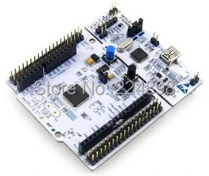
STM32 overview
STM32F103RBT6

Slide 2
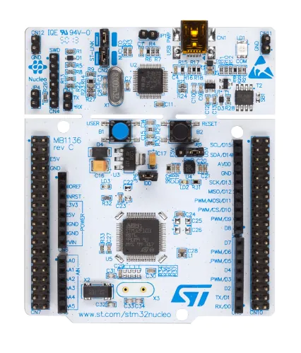
Features of STM32F103RBT6 click here
Datasheet of STM32F103RBT6 click here
We can STM32 by using Arduino IDE or by using
STM32cubeIDE
For setup of programming STM32 with Arduino IDE
click here

Slide 3
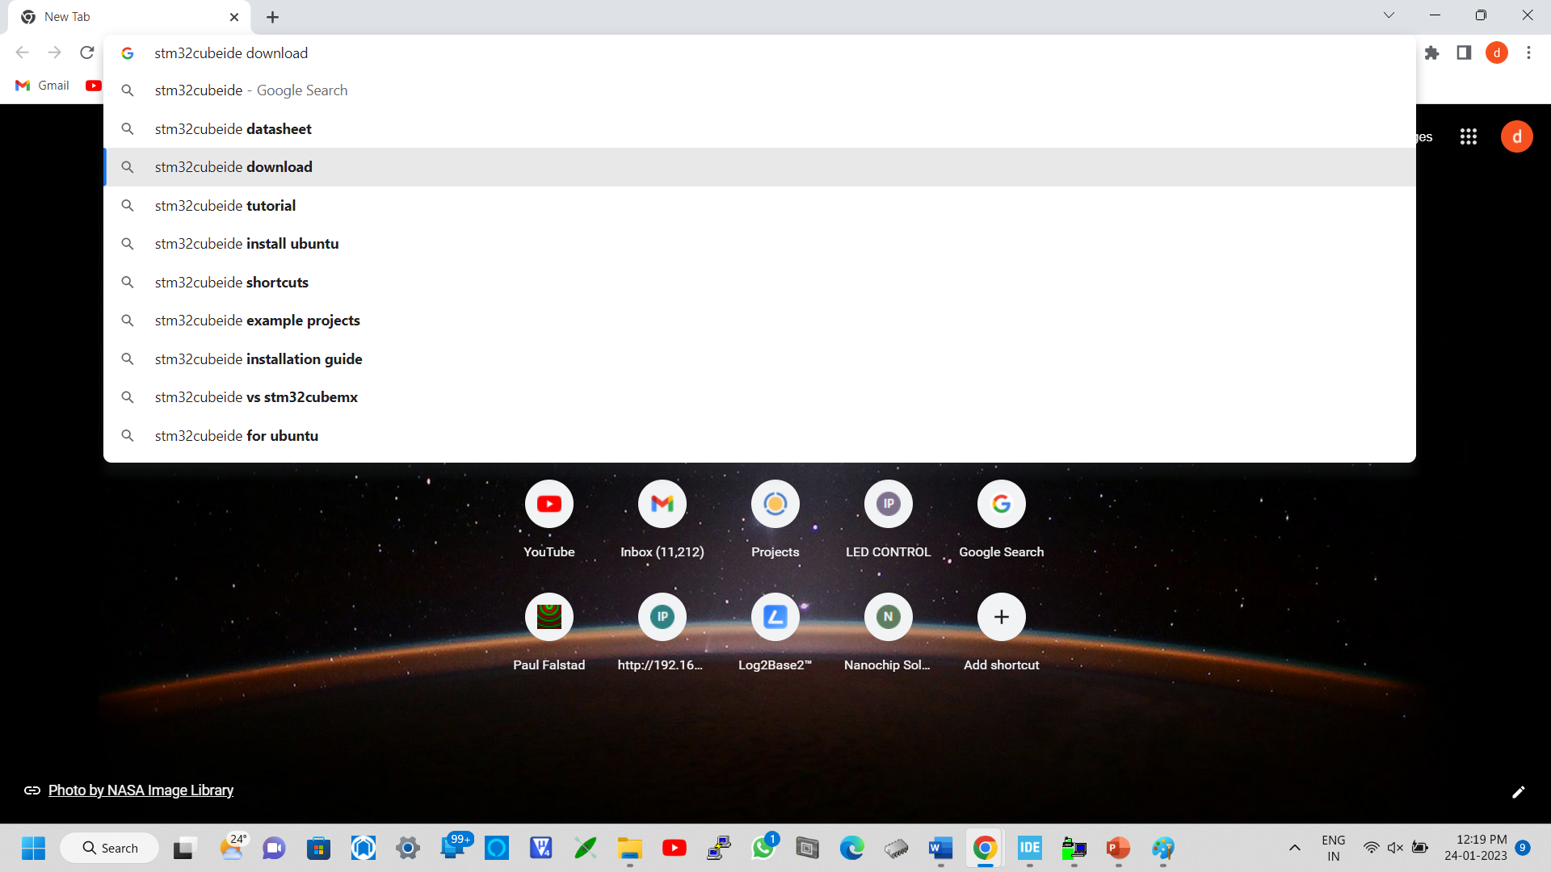
Setup STMcube IDE

Slide 4
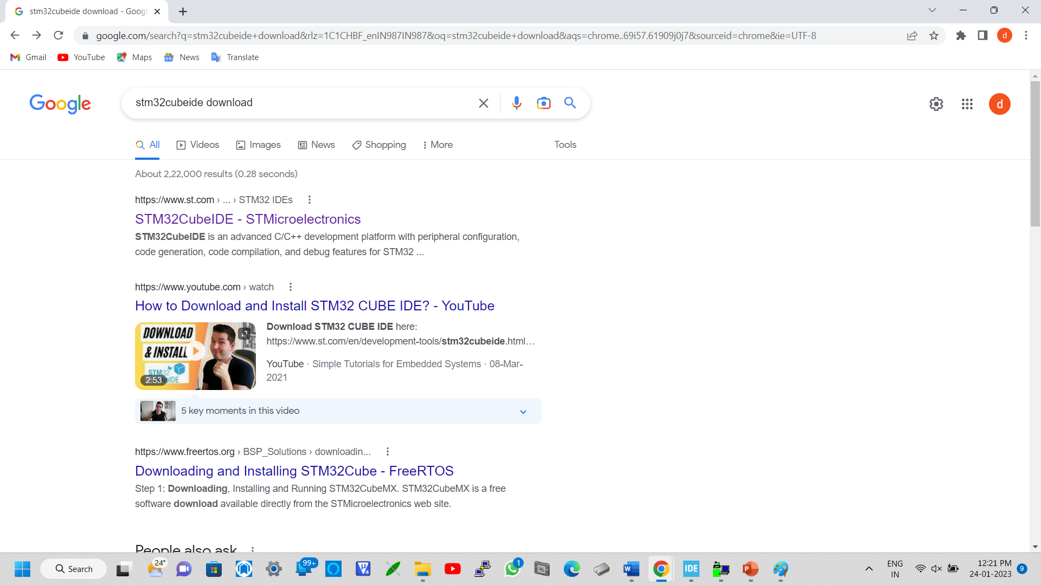


Slide 5
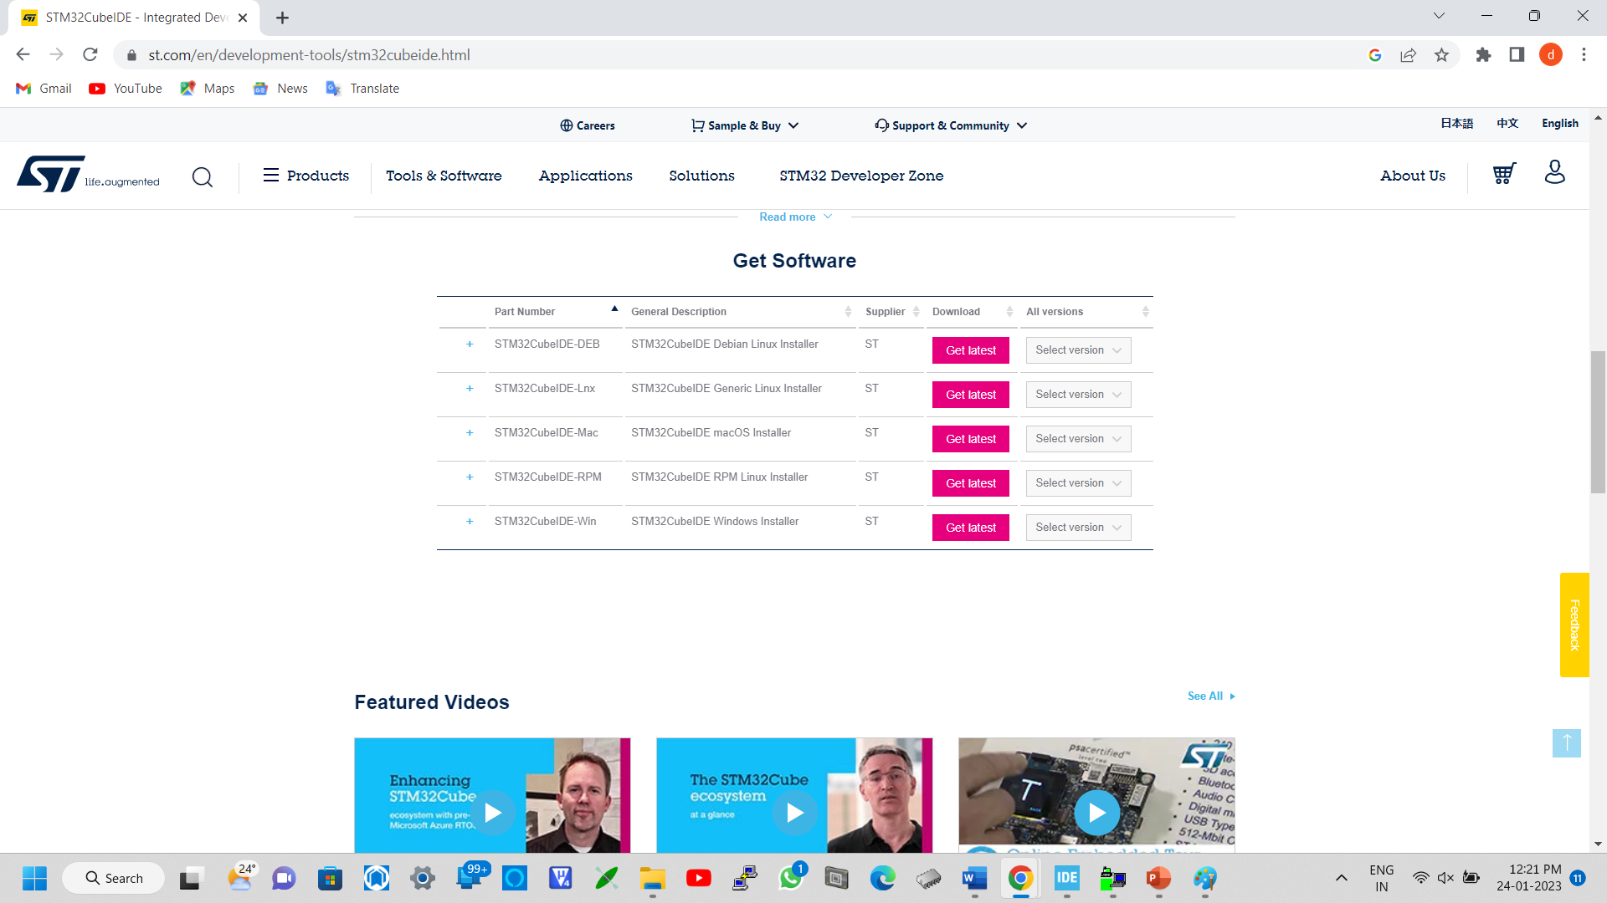

Slide 6
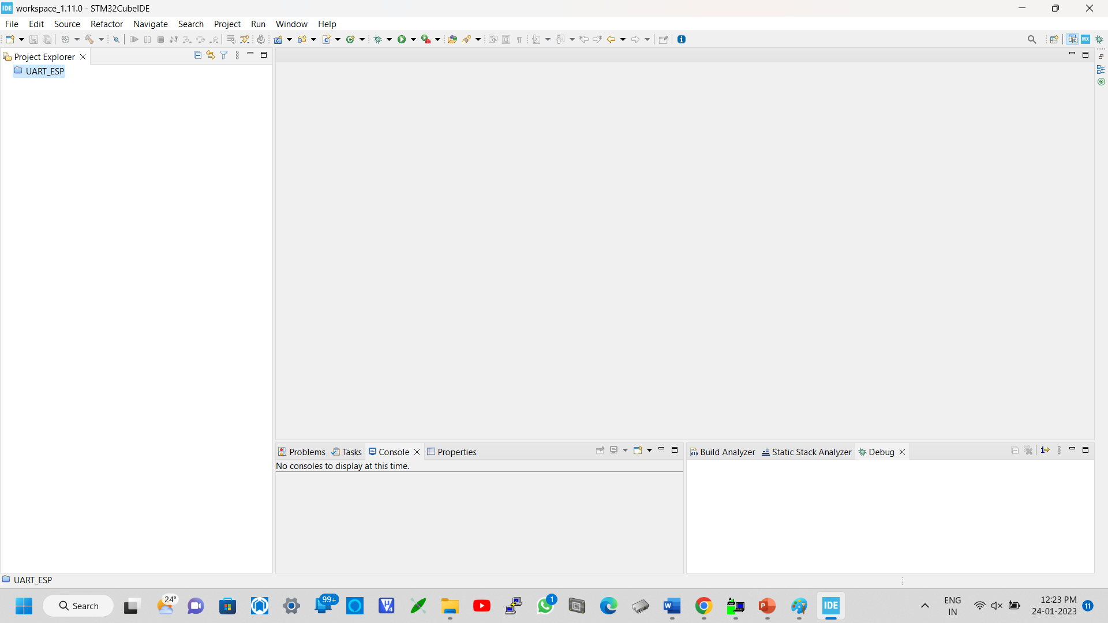


Slide 7
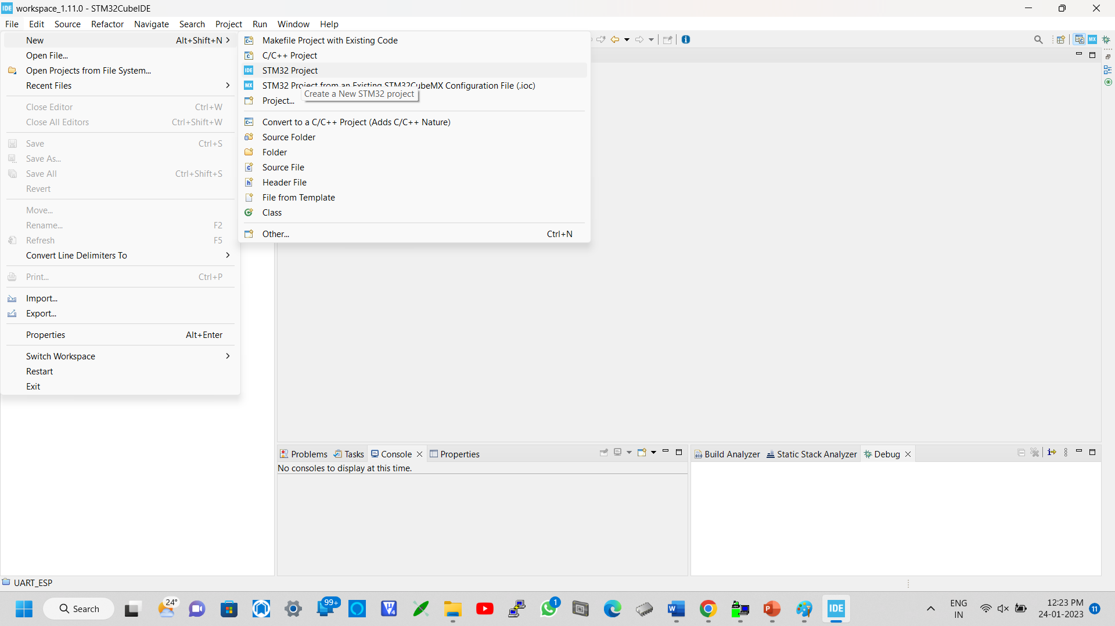



Slide 8
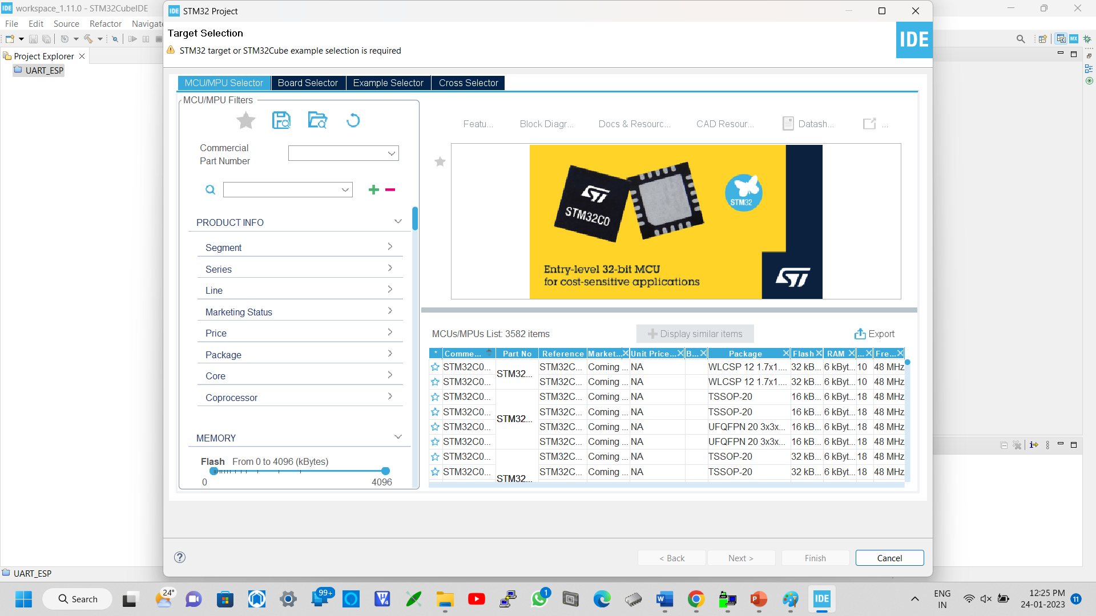

Slide 9
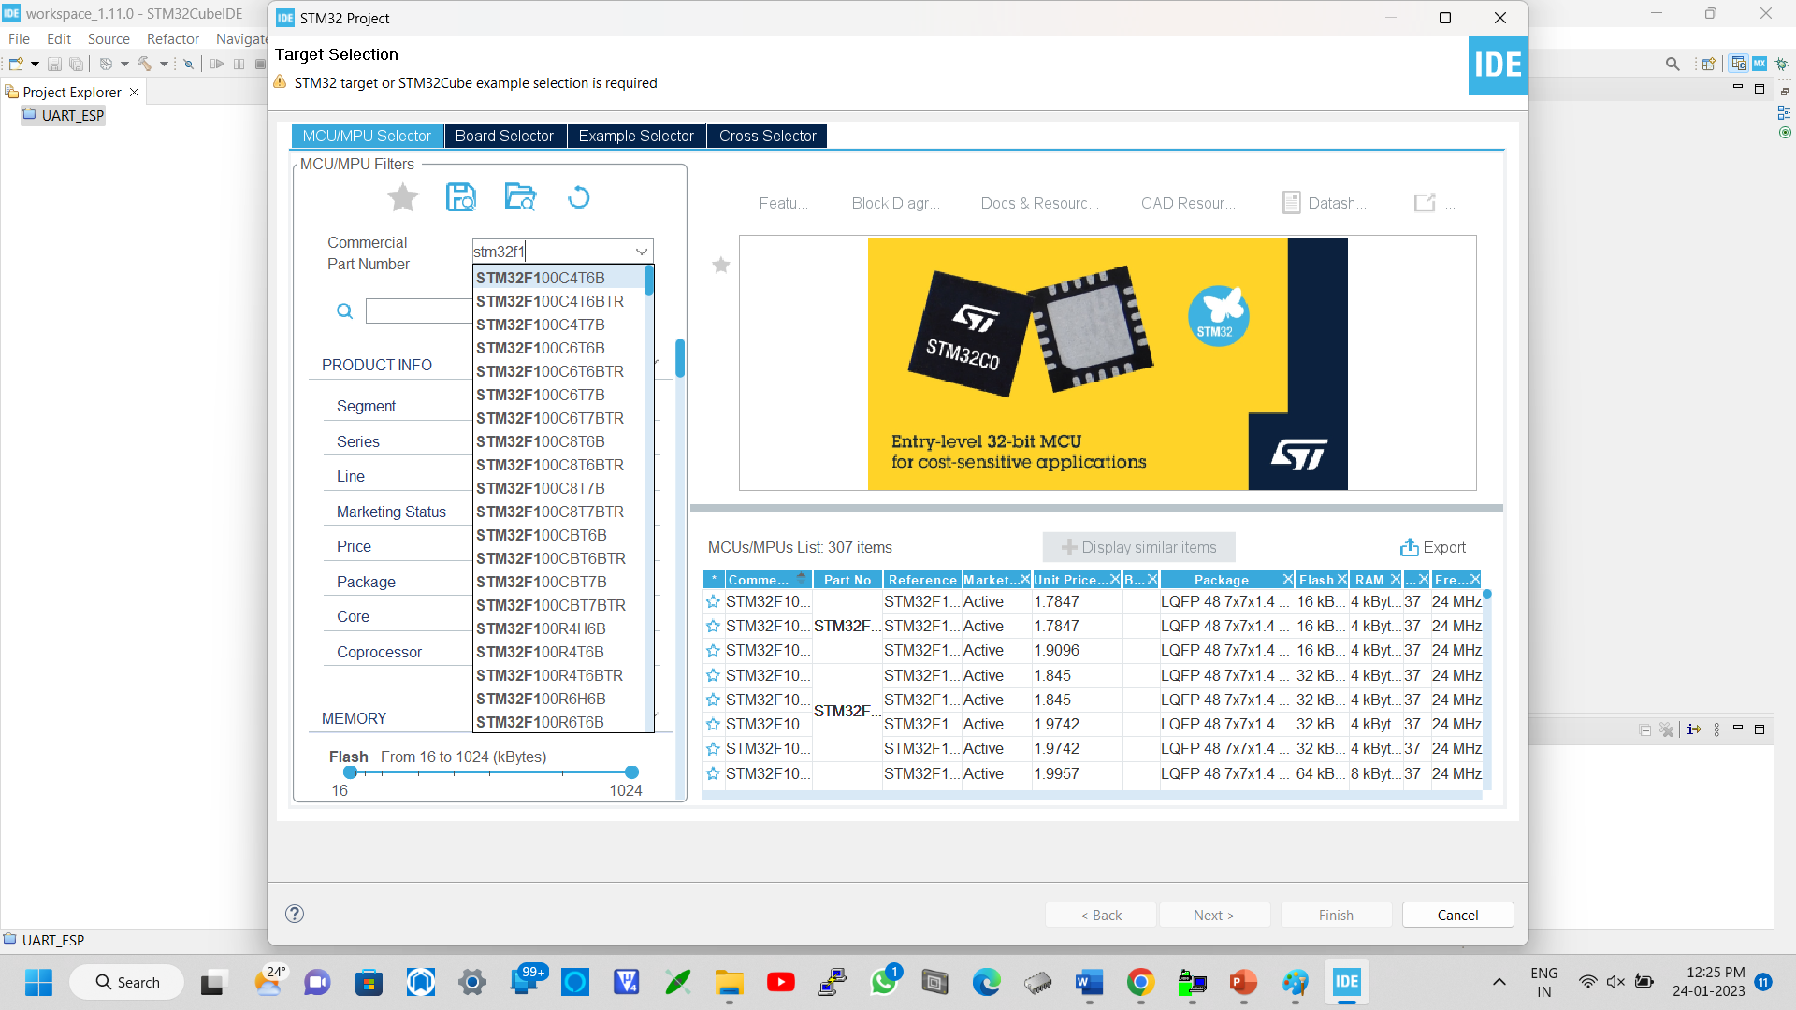


Slide 10
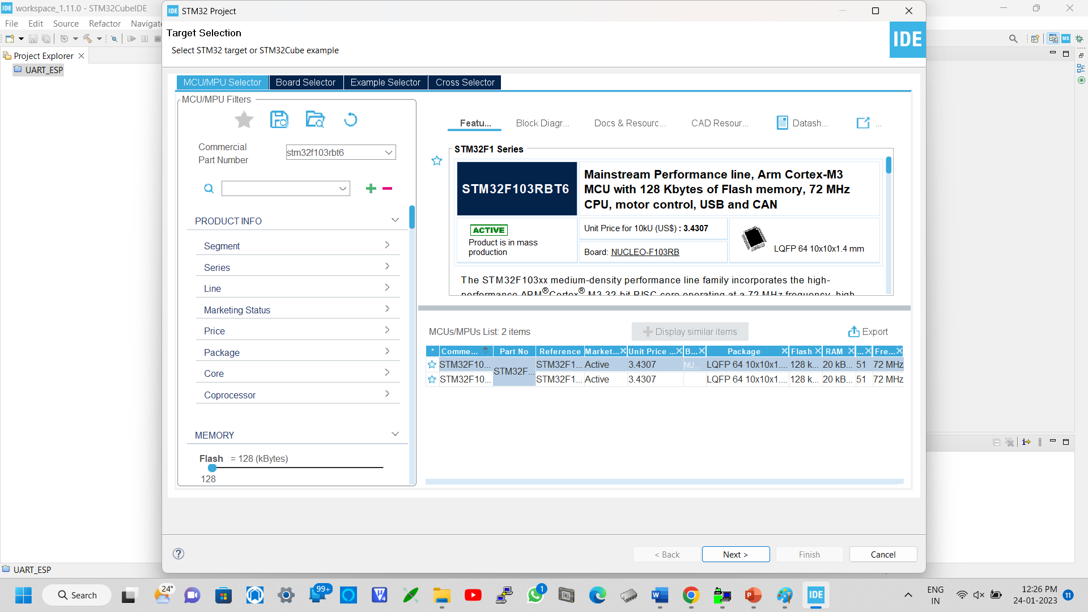




Slide 11
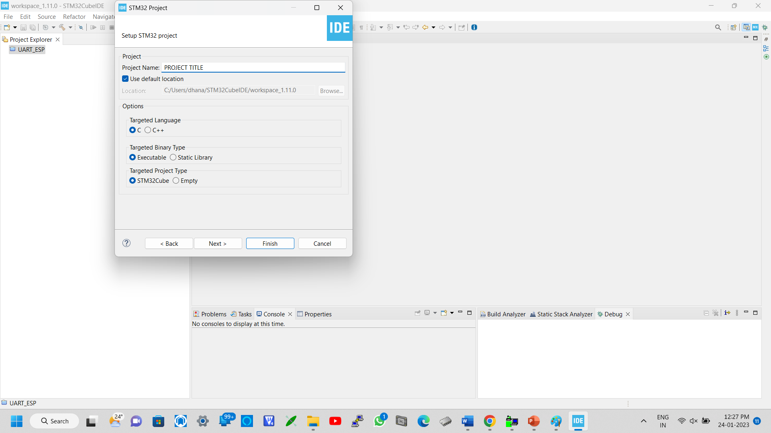



Slide 12
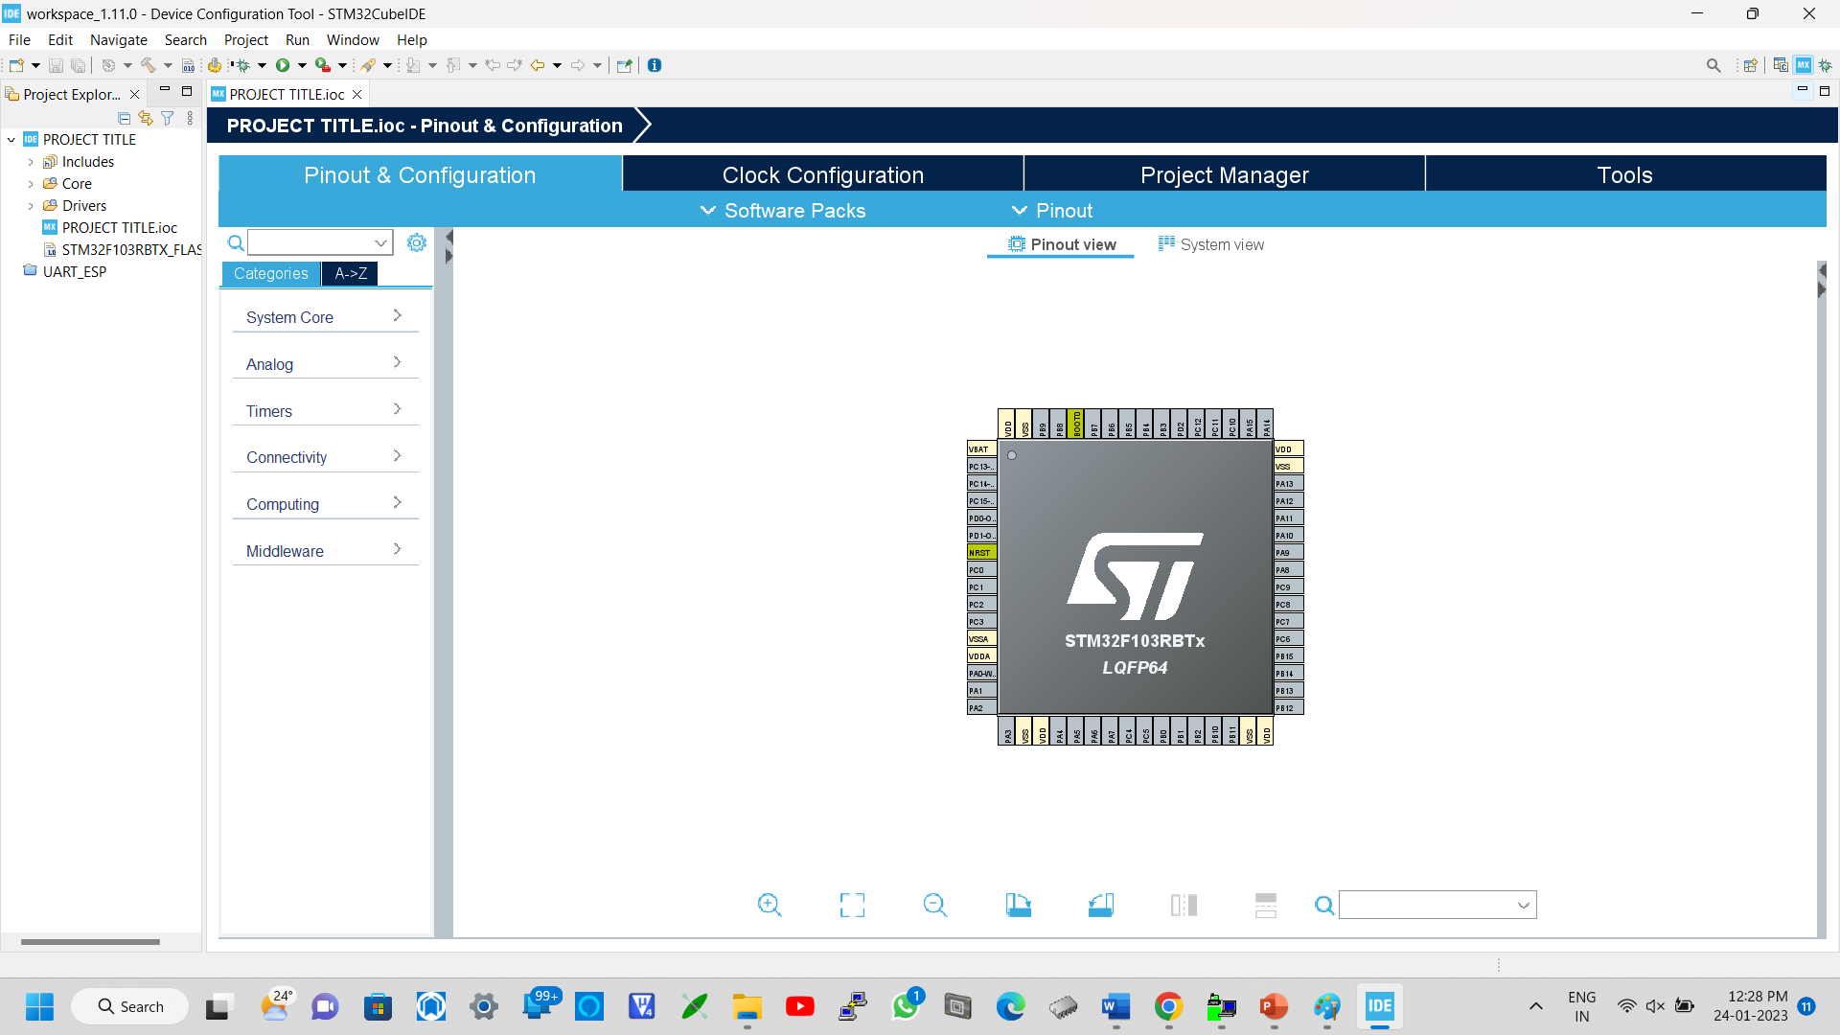

Slide 13


